Slide 1
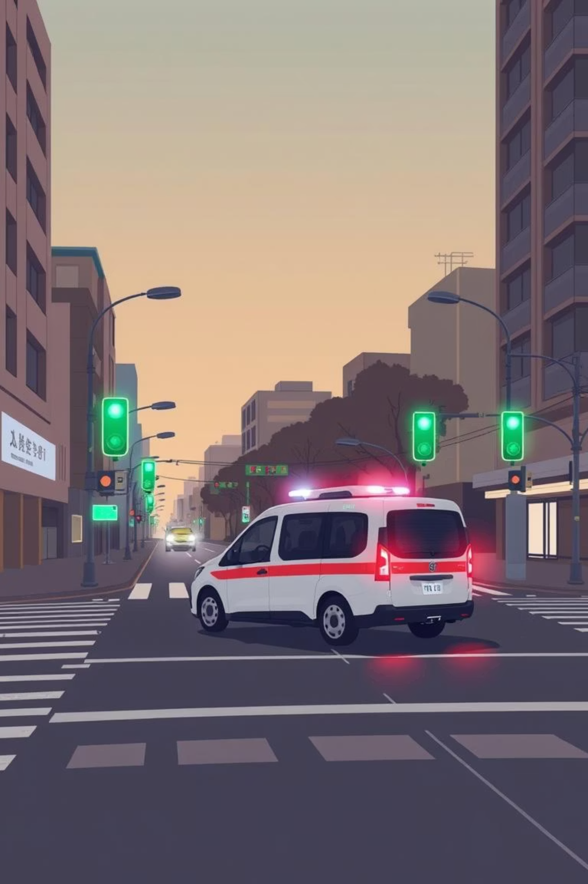
Emergency Vehicle Priority Routing System
TEAM – 15

Slide 2
Agenda
System Architecture Overview
Edge Layer: Local Intelligence
Fog Layer: Networked Coordination
Cloud Layer: Centralized Optimization
Real-time detection and immediate response at the intersection.
Intelligent routing and "green wave" creation across multiple intersections.
AI model training, system updates, and city-wide traffic analytics.

Slide 3
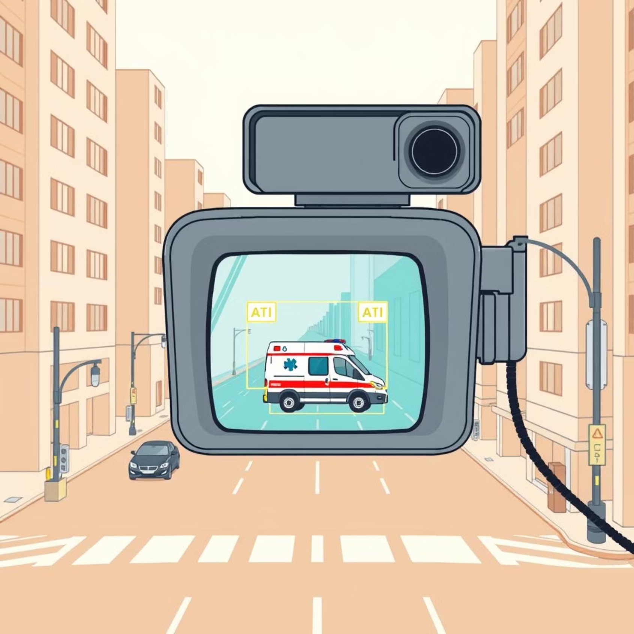


Edge Layer: The Eyes & Reflexes of the Intersection
The Edge Layer is responsible for real-time analysis and immediate action at each smart intersection. It operates autonomously, ensuring critical responses are executed without delay.
Cameras
Multiple high-resolution feeds.
Edge Device
Local AI processing (Jetson Nano).
Controller
Executes light changes.

Slide 4
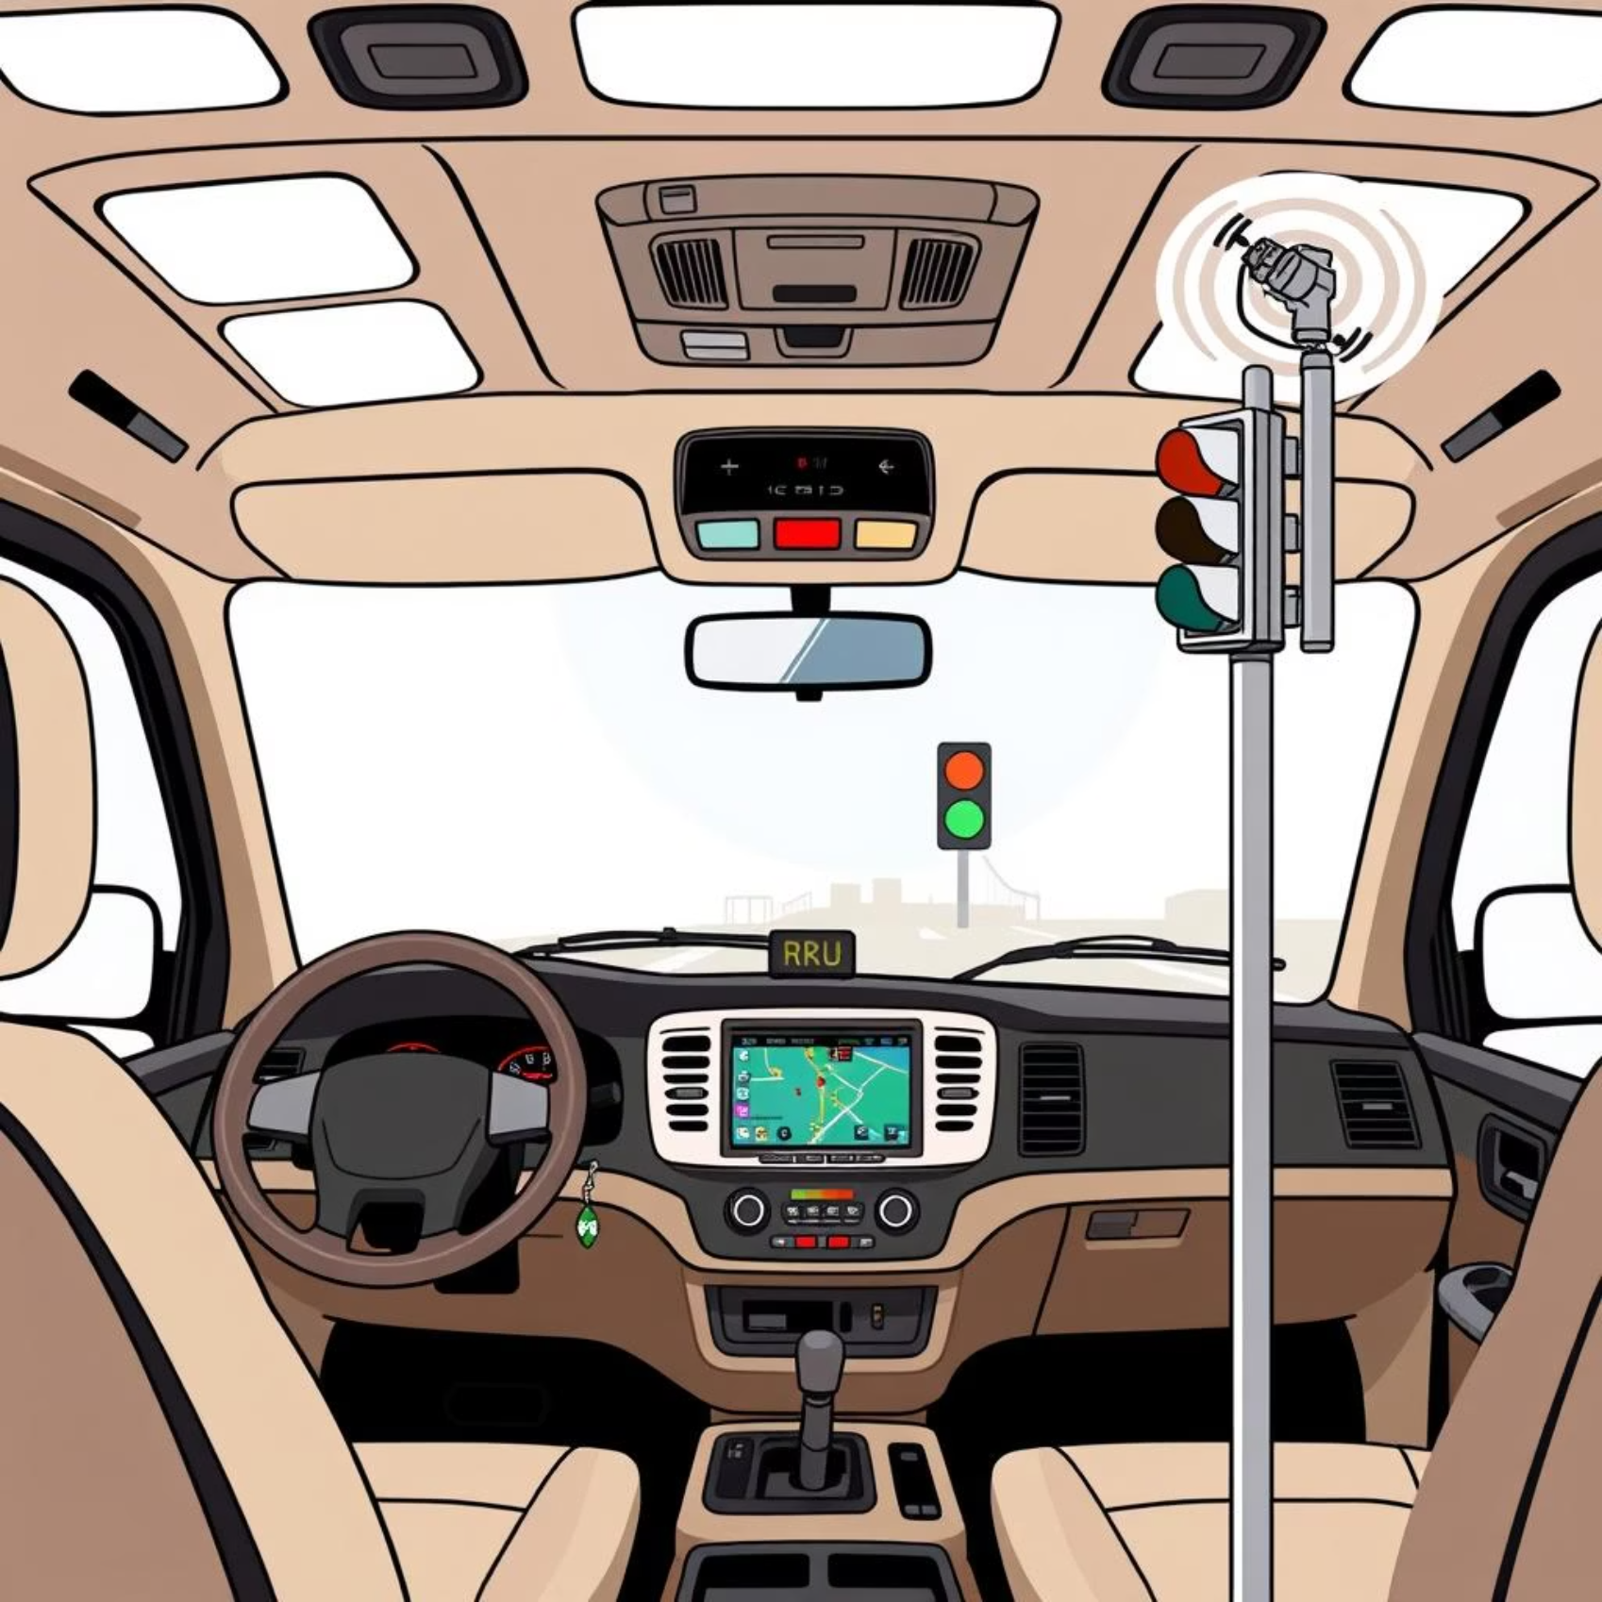
Edge Layer :The OBU/RSU System
OBU (On-Board Unit)
Location: Inside the emergency vehicle (e.g., ambulance).
Function: Driver sets priority level (e.g., Code Black for
critical emergencies).
Action: Continuously broadcasts priority code.
RSU (Road-Side Unit)
Location: Mounted at the intersection (e.g., on traffic light poles).
Function: Listens for and reads priority codes from nearby OBUs.
Data: Provides real-time urgency context to the local brain.

Slide 5
Edge Layer: Core Responsibilities and Superpowers
Real-time Detection & Action
Ultra-low Latency Reflex
Enhanced Data Privacy
Utilizes a YOLO AI model to continuously analyze video feeds, instantly detecting emergency vehicles. Upon detection, it issues an immediate SET_GREEN command to clear the local lane, and sends an AMBULANCE_ALERT to the Fog Layer.
Superpower: Achieves near-instantaneous response times (milliseconds) for critical interventions. The system prioritizes speed to ensure maximum safety.
Superpower: Video processing occurs locally on the edge device, minimizing data transmission and enhancing privacy by reducing the need to send raw video feeds to a centralized server.

Slide 6
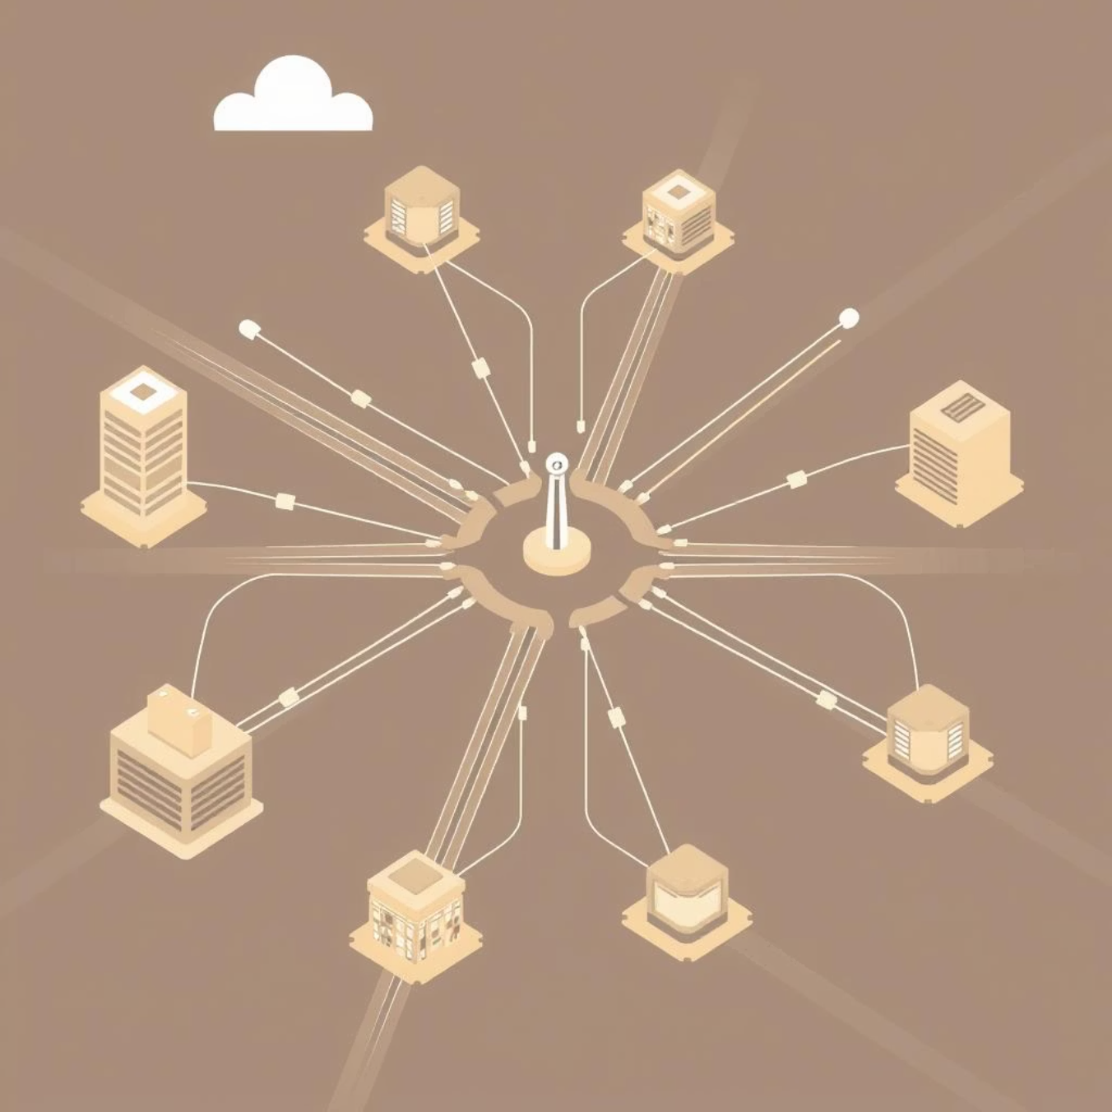
Fog Layer: The Intelligent Swarm for Coordinated Routing
The Fog Layer acts as a decentralized network of communicating intersection agents. It orchestrates intelligent routing to create a seamless "green wave" for emergency vehicles.
01
Receive Alert
Receives AMBULANCE_ALERT from edge device.
02
Communicate & Share
Interacts with neighboring agents for real-time traffic data.
03
Optimal Pathfinding
Executes swarm intelligence (e.g., Ant Colony Optimization) to determine the
least congested path.
04
Coordinated Control
Sends commands to intersections along the path to ensure "green wave" progression.

Slide 7
Fog Layer: Key Strengths and Adaptability
The Fog Layer's distributed intelligence provides crucial advantages for dynamic urban environments.
Decentralized & Intelligent Routing
Adaptive to Dynamic Conditions
Robust System Architecture
Each intersection contributes to global pathfinding, ensuring optimal, real-time routes.
Constantly adjusts to traffic flow, accidents, and sudden changes, maintaining efficiency.
No single point of failure; if one node goes offline, the network re-routes and continues operation.

Slide 8

Cloud Layer: The AI Factory & Strategic Archive
The Cloud Layer serves as the central hub for AI model development, system-wide updates, and long-term data storage, providing invaluable insights for urban planning.
AI Model Training: Trains YOLO models on massive, city-wide video datasets.
Centralized Deployment: Distributes updated and improved models to all edge devices.
Data Logging: Archives emergency events, routes, and clearance times for long-term analysis.
City-wide Analytics: Provides data for comprehensive traffic analysis and system performance tracking.

Slide 9
Key Takeaways: A Resilient, Responsive, and Intelligent System
Unprecedented Emergency Response
Scalable & Future-Proof
Modular architecture allows for easy expansion and integration of new AI models and traffic management strategies.
Dramatic reduction in emergency vehicle response times through automated "green waves" and intelligent routing.
Data-Driven Urban Planning
Enhanced Safety & Efficiency
Rich data insights from the Cloud Layer empower cities to make informed decisions for infrastructure and policy.
Optimizes traffic flow for all vehicles, reducing congestion and improving overall urban mobility and safety.

Slide 10



State-of-the-Art Literature
Our solution integrates the latest advancements across several critical domains, building upon a robust foundation of research and development.
Advanced Computer Vision
Secure V2X Communication
Distributed Edge Intelligence
Leveraging breakthroughs in deep learning and AI models for highly accurate, real-time detection and classification of emergency vehicles in complex traffic scenes.
Incorporating Vehicle-to-Everything (V2X) communication standards for reliable, low-latency data exchange between vehicles and roadside infrastructure.
Utilizing edge computing paradigms to process data and make critical decisions locally, reducing reliance on centralized cloud systems for immediate actions.

